Slide 1
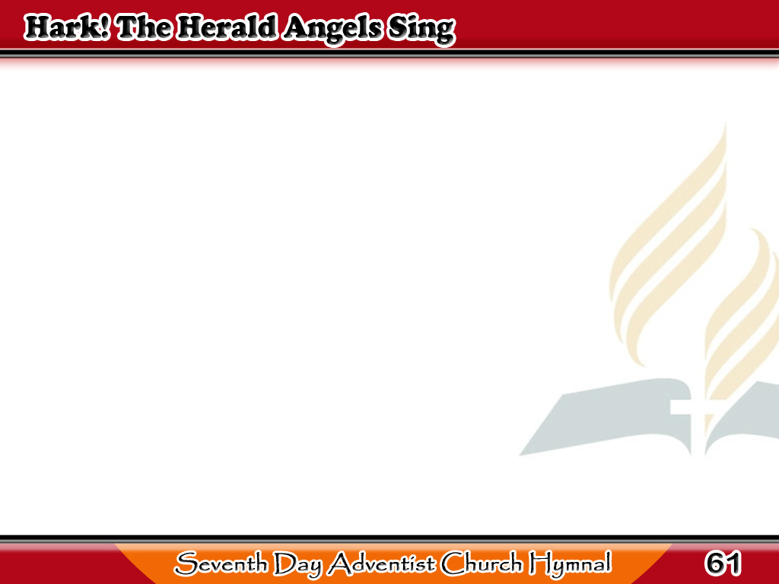
Dinggin at Umaawit mga Anghel sa Langit
Hark the herald angels sing,
“Glory to the newborn King;
Peace on earth, and mercy mild,
God and sinners reconciled!”
1/3

Slide 2
Dinggin at Umaawit mga Anghel sa Langit
Joyful, all ye nations, rise,
Join the triumph of the skies;
With th’angelic host proclaim,
“Christ is born in Bethlehem!”
1/3

Slide 3
Dinggin at Umaawit mga Anghel sa Langit
-Refrain-
Hark! The herald angels sing,
“Glory to the newborn King.”
1/3

Slide 4
Dinggin at Umaawit mga Anghel sa Langit
Christ, by highest heaven adored,
Christ the everlasting Lord;
In the manger born a king,
While adoring angels sing,
2/3

Slide 5
Dinggin at Umaawit mga Anghel sa Langit
“Peace on earth,
to men good will;”
Bid the trembling soul be still,
Christ on earth has come to dwell,
Jesus, our Immanuel!
2/3

Slide 6
Dinggin at Umaawit mga Anghel sa Langit
-Refrain-
Hark! The herald angels sing,
“Glory to the newborn King.”
2/3

Slide 7
Dinggin at Umaawit mga Anghel sa Langit
Hail! The heaven born
Prince of Peace!
Hail! the Sun of righteousness!
Life and light to all He brings,
Risen with healing in His wings.
3/3

Slide 8
Dinggin at Umaawit mga Anghel sa Langit
Mild He lays His glory by,
Born that man no more may die,
Born to raise the sons of earth,
Born to give them second birth.
3/3

Slide 9
Dinggin at Umaawit mga Anghel sa Langit
-Refrain-
Hark! The herald angels sing,
“Glory to the newborn King.”
3/3

